Slide 1


Adventure works project
Project Kick-off meeting

Slide 2

REVIEW MEETING TIMELINES
Date | Time | Task Description
06-Jan-2025 | 12pm – 1pm | Project Kick-off Meeting
13-Jan-2025 | 12pm – 1pm | Implementation of KPI’s using Excel
20-Jan-2025 | 12pm – 1pm | Implementation of KPI’s using Tableau & SQL
27-Jan-2025 | 12pm – 1pm | Implementation of KPI’s using Power BI
03-Feb-2025 | 12pm – 1pm | Final Presentation of the Project

Slide 3
ABOUT THE DATASET
Adventure Works Cycles, the company on which the Adventure Works sample databases are based, is a large, multinational manufacturing company. The company manufactures and sells metal and composite bicycles to North American, European and Asian commercial markets.
In 2000s, Adventure Works Cycles bought a small manufacturing plant in Mexico. Which manufactures several critical subcomponents for the Adventure Works Cycles product line. These subcomponents are shipped to the Bothell location for final product assembly. In 2001, this manufacturing plant became the sole manufacturer and distributor of the touring bicycle product group.
Coming off a successful fiscal year, Adventure Works Cycles is looking to broaden its market share by targeting their sales to their best customers, extending their product availability through an external Web site, and reducing their cost of sales through lower production costs.

Slide 4
ABOUT THE DATASET
About | Description
Domain | Retail/ E-commerce/ Manufacturing
Project | Adventure Works Project
Datasets | DimCustomer | DimDate | DimSalesTerritory
 | DimProduct | DimProductCategory | DimProductSubCategory
 | Fact_Internet_Sales_new | FactInternetSales
Dataset Type | Microsoft Excel File (.xlsx)
Dataset Size | 10.1 MB

Slide 5
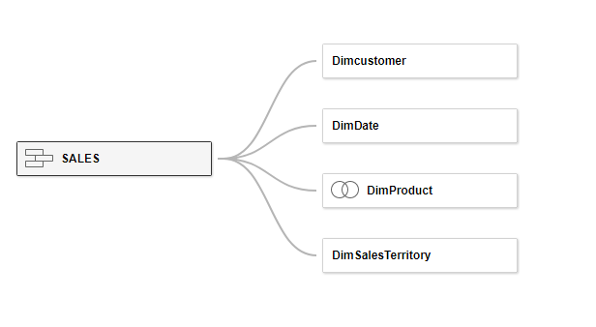
ABOUT THE DATASET

Slide 6
EVALUATION CRITERIA
Your project presentation will be evaluated based on the following four key performance factors:
Technical Skills
Collaboration with Teammates
Communication
Planning and Execution
Please ensure your presentation reflects these factors for a well-rounded evaluation.

Slide 7
EXTRA TASKS TO DO
In Adventure Works project, the goal is typically to analyze the dataset to uncover insights and answer key business questions.
Following are some extra Analysis you can try for
Sales Performance Analysis
Customer Behavior Insights
Inventory and Product Analysis
Operational Efficiency

